Slide 1
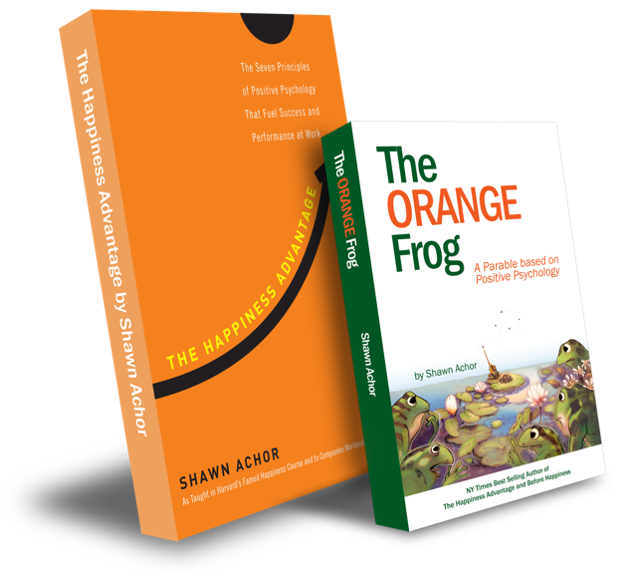
Conscious Acts
Of
Kindness

Slide 2
Week Three

Slide 3
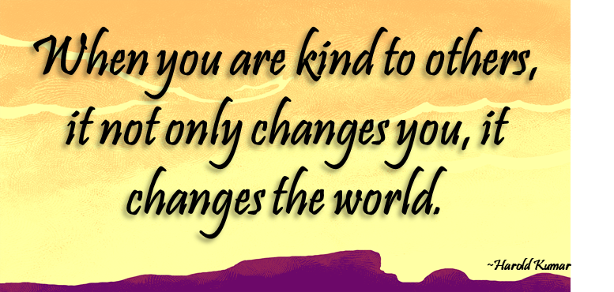
Learning Objective:
I can identify why it feels good to be kind to others.
I will discuss how being kind to others can be rewarding.
Notes:
Standard:
Essential Concept and/or Skill: Communicate and work productively with others emphasizing collaboration and cultural awareness to produce quality work.
Interact positively as a team member.
Cooperate with others in a group setting.
Generate ideas with group members.
Are active listeners.
Read and understand information in a variety of forms.
Express ideas.
Skill:
Active listening, express ideas

Slide 4
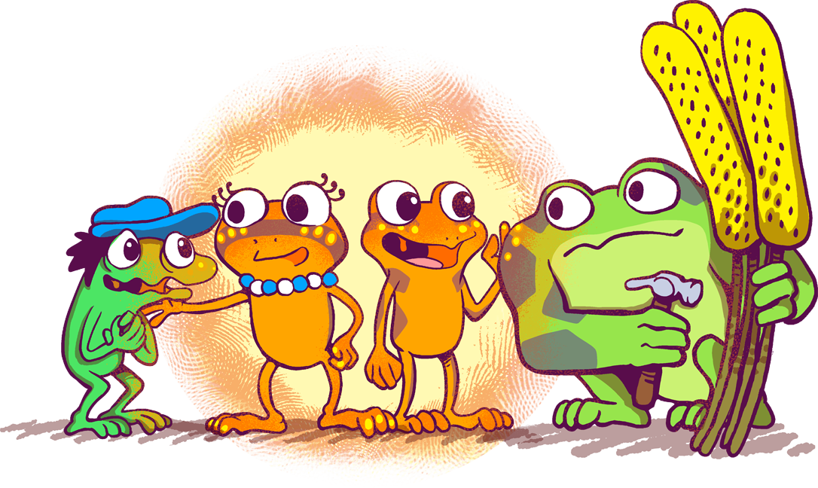
Skills
Relationship skills
Social awareness
“It always seems impossible until it’s done.”
~Nelson Mandela

Slide 5
Questions
What does it mean to feel a sense of accomplishment?
What can you do to make yourself feel a sense of accomplishment?
“Every Accomplishment Starts with the Decision to Try.”

Slide 6
Thoughts
There are so many good things that happen when we are kind to others such as there are positive chemicals released in our brain, there are new relationships formed, there is self-esteem built. One of the most important things that happens is when we are kind to others is that it helps us to feel good. We learn things about ourselves when we take time out of our day to be kind to others.

Slide 7
Activity
Today, we are going to try to figure out what the impact is of doing a CAOK. We are going to interview someone and develop questions to best decide what happens after a CAOK has occurred.
1
Successful people ask questions. They seek new teachers. They’re always learning.
Develop 3 questions you wish to ask.
2
Pick who you are going to interview.
G
It’s important that they first find someone who has had a CAOK. If they haven’t experienced a CAOK, they won’t qualify.

Slide 8
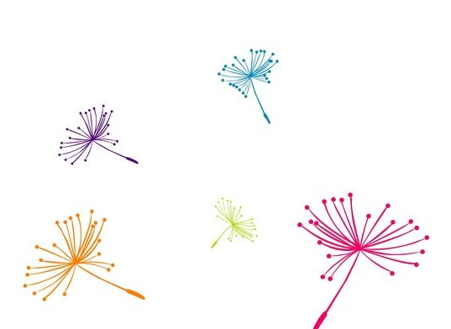
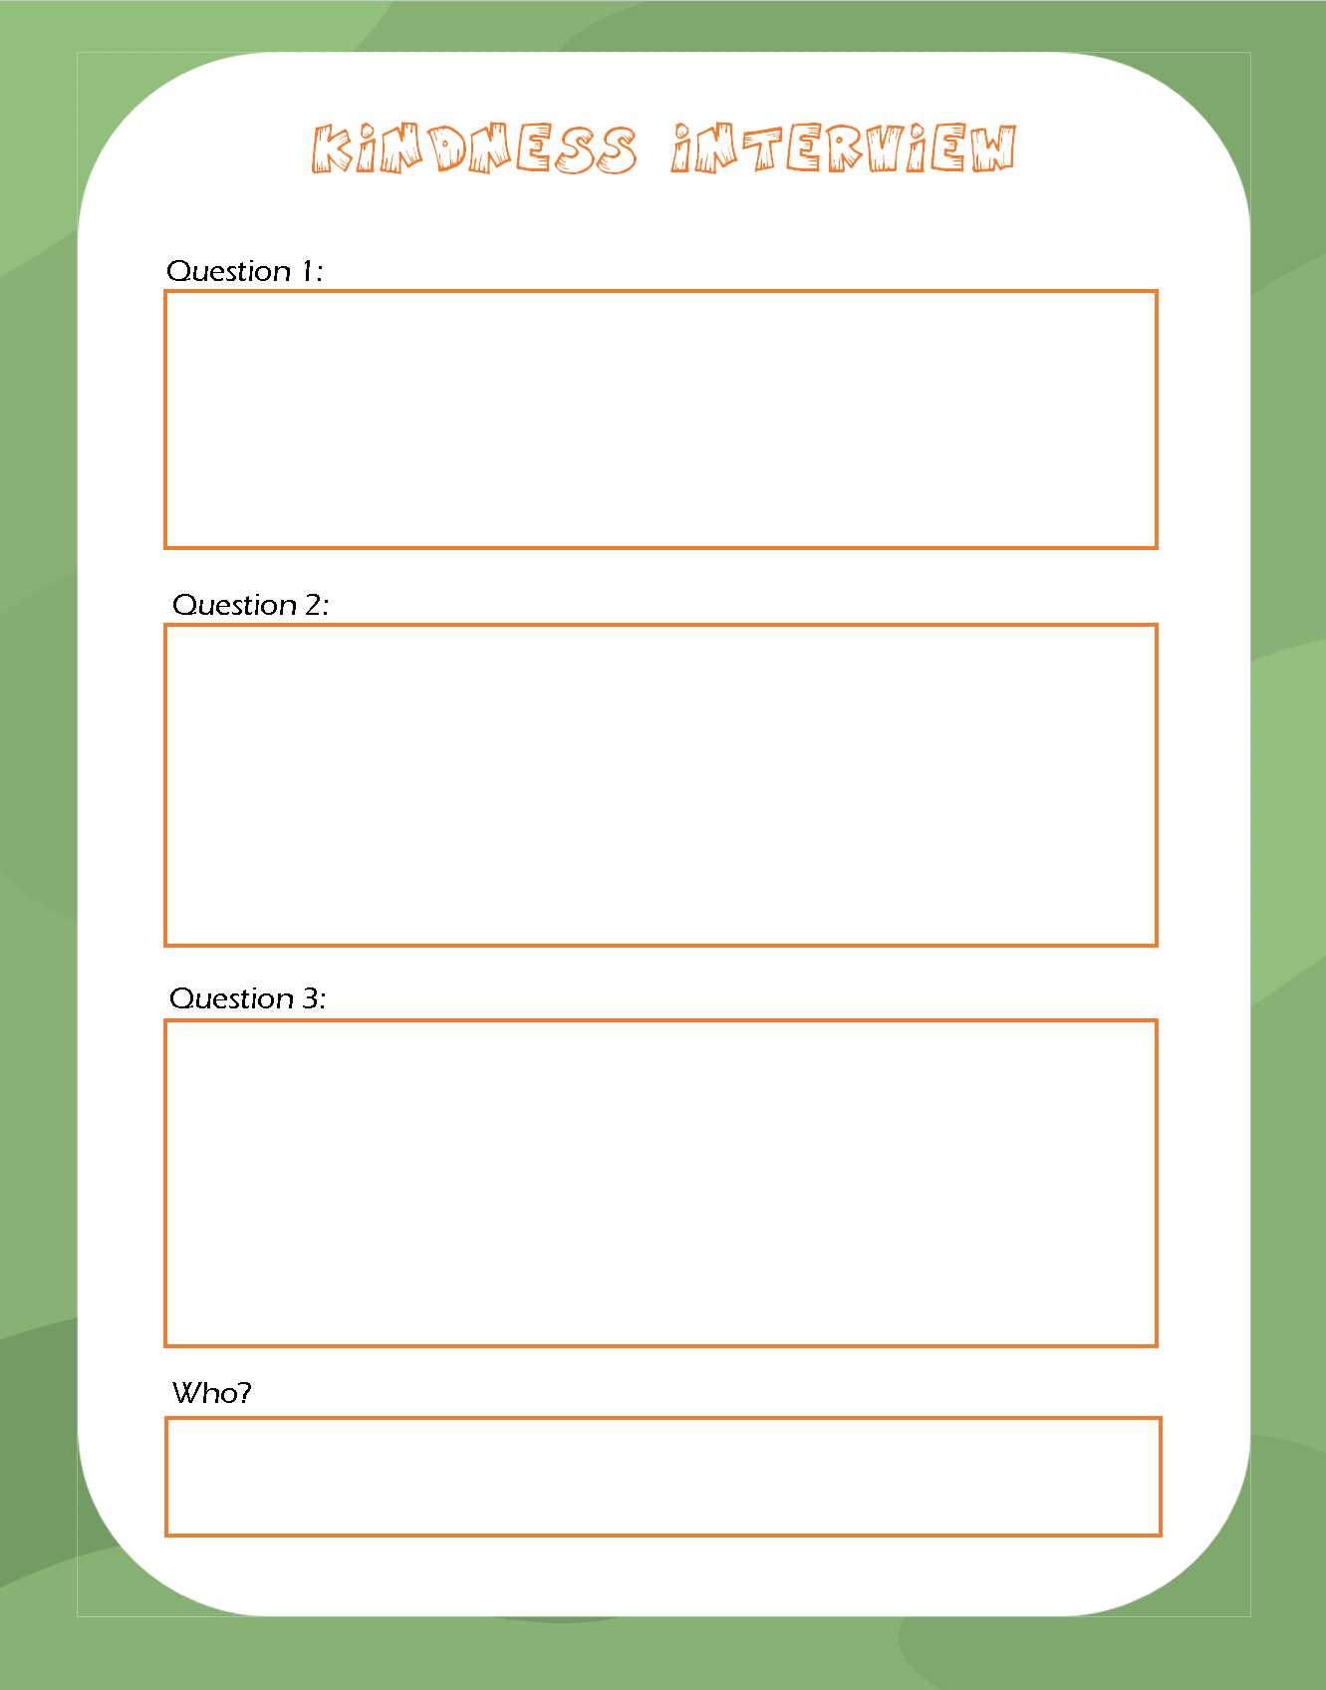
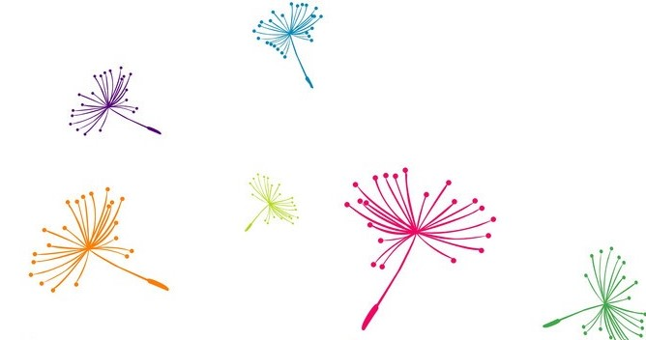
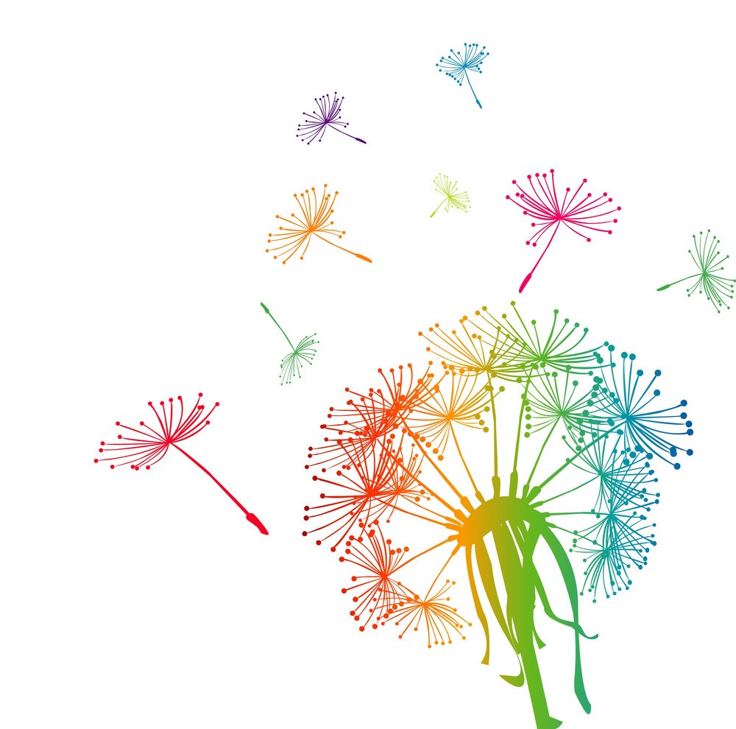
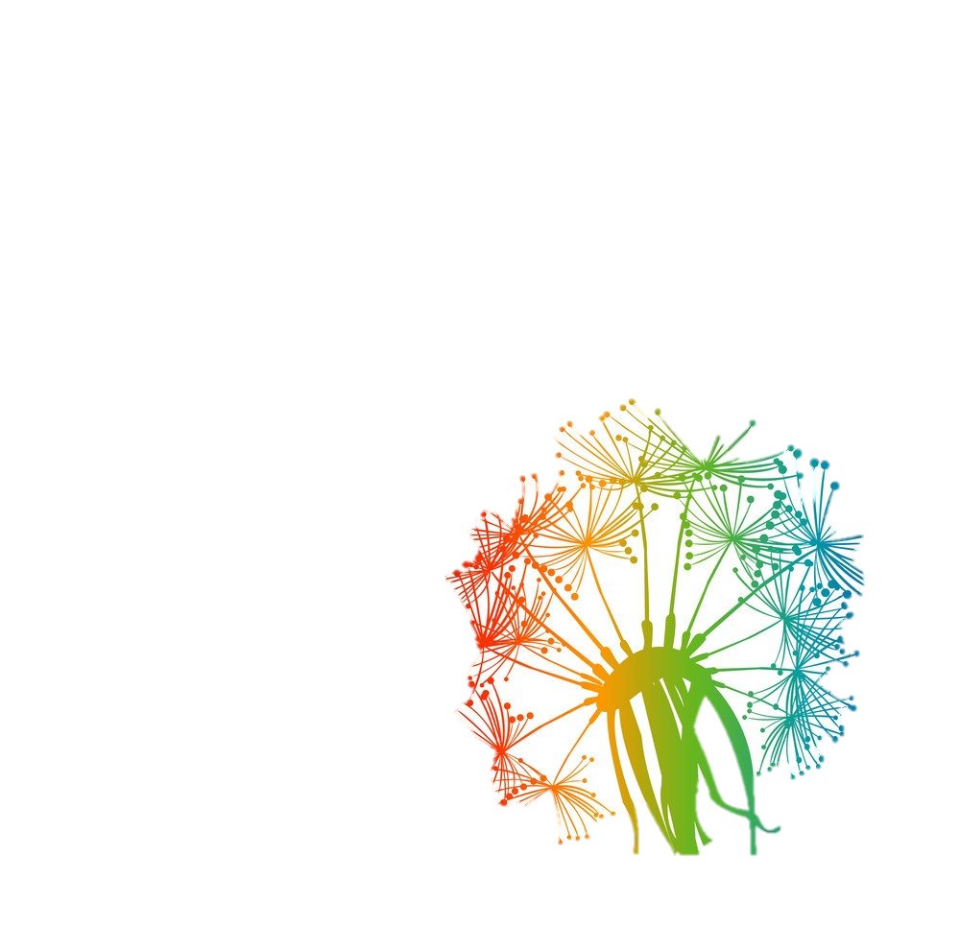
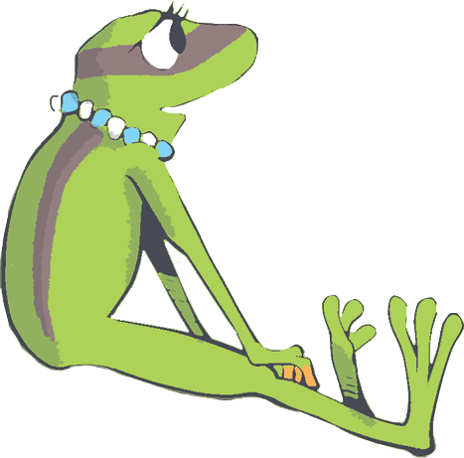
Others
Lifting
By
Rise
We

